Slide 1




Test Automation with Selenium WebDriver
Selenium Introduction, Record Actions, Use Selenium API in Java
QA
Fundamentals
Ivan Yonkov
Technical Trainer
Software University
http://softuni.bg

Slide 2

Table of Contents
Test Automation Introduction
Selenium Introduction
Selenium IDE
Recording a Firefox Action
Exporting Test Cases
Using Selenium WebDriver Java API
Select Elements
Send Keys
Assertions

Slide 3

Automat…ion

Slide 4
What is Test Automation?
Executing repetitive but necessary tasks
Login, registration, etc…
Comparing the actual and expected outcomes
Checking visual result
Checking api responses
Adding a test to difficult to perform manual actions
Big scenario e.g. login the user, then add some products to cart, then check database, then checkout the cart, etc…

Slide 5

Selenium

Slide 6
Introduction to Selenium?
Framework and a tool for web automation
Consists of two components
Selenium IDE – record/playback tool for Firefox
Selenese – A domain-specific language
Selenium WebDriver – API For most of the popular languages

Slide 7
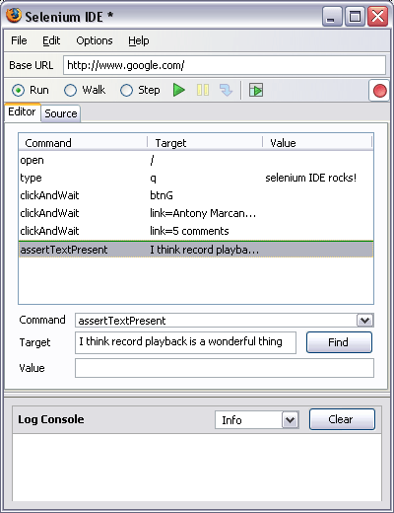
Selenium IDE

Slide 8
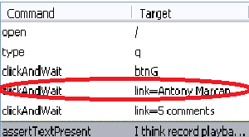
Selenium IDE (2)
Recording actions
Using selectors/xpath for interaction
Has basic own api for various actions (click, wait, select, etc..)

Slide 9
Selenium IDE - Live Demo

Slide 10

Selenium WebDriver
Library for automating scripts in various languages (Java, C#, Ruby, Python, PHP…)
Uses unit testing engine for a lot of the core actions
Has API for all web-browser actions a user can do

Slide 11

Selenium WebDriver API

Slide 12
Selenium WebDriver API (2)
Maven dependencies
<dependency>
<groupId>org.seleniumhq.selenium</groupId>
<artifactId>selenium-java</artifactId>
<version>2.45.0</version>
</dependency>

Slide 13
Selenium WebDriver API (3)
Setup a test class
public class MyTest {
private WebDriver driver;
private String baseUrl;
private boolean acceptNextAlert = true;
private StringBuffer verificationErrors = new StringBuffer();
}

Slide 14
Selenium WebDriver API (4)
Setup an initializer
@Before
public void setUp() throws Exception {
this.driver = new FirefoxDriver();
this.baseUrl = "http://application.to.test.com";
this.driver
.manage().timeouts().implicitlyWait(30, TimeUnit.SECONDS);
}

Slide 15
Selenium WebDriver API (5)
Click on an element
Find the element – findElement()
Use a certain selector – The “By” class
Perform an action – click()
this.driver
.findElement(By.id(“submit-btn")).click();

Slide 16
Selenium WebDriver - Live Demo

Slide 17
Summary
Test automation theory
Selenium IDE – record, play, export case
Selenium WebDriver – using Java Library with Maven and JUnit to automate a simple scenario
The findElement() method
The By static class
Selector methods

Slide 18









Test Automation Introduction

Slide 19
License
This course (slides, examples, demos, videos, homework, etc.) is licensed under the "Creative Commons Attribution-NonCommercial-ShareAlike 4.0 International" license
Attribution: this work may contain portions from
"ASP.NET MVC" course by Telerik Academy under CC-BY-NC-SA license

Slide 20





Free Trainings @ Software University
Software University Foundation – softuni.org
Software University – High-Quality Education, Profession and Job for Software Developers
softuni.bg
Software University @ Facebook
facebook.com/SoftwareUniversity
Software University @ YouTube
youtube.com/SoftwareUniversity
Software University Forums – forum.softuni.bg

